Slide 1
Deeper Training and Learning
A Guide to Sharing Knowledge & Skills
William T Batten
Copyright 2022 William T Batten. All rights reserved. No part of this may be used without the written consent of the owner.

Slide 2
What is this course?
This course is two things:
It’s a deep exploration of presentation skills, course design and learning resource development. If you want to share knowledge and skills, you’ll learn a lot.
It’s a sample of my course design and development skills. Notice how engaging and effective a course I created using nothing but PowerPoint – a tool that’s often the bane of the learner.
Want to contact me? You can find me at the following places:
https://williamtbatten.com/
https://www.linkedin.com/in/battenwilliam/

Slide 3
Thanked for teaching?
In my old job, I used to teach a few courses. They weren’t what most folks would call exciting – a corporate induction, using Microsoft Excel, stuff like that.
About four years after running that course, I changed roles. I relocated from an auxiliary site to the main headquarters. Even though my new desk was tucked away in an obscure, hard to reach corner of the building…
… it look less than 30 minutes for someone to recognise me and thank me for those courses.
That wasn’t the first time someone stopped me in a hallway to thank me like that.
It wasn’t even the last. A year after leaving that organisation, a friend of a work friend recognised me and, you guessed it, thanked me.
How would you like to deliver training so good,
the learners thank you for it?

Slide 4
What’s in it for you?
By the end of this training, you’ll be able to:
Craft learning experiences around the learners’ needs, knowledge level and expectations,
Instil the right attitude in learners before the course even begins, when you clearly define what the learners will get from your course,
Keep the learners’ attention and enthusiasm from start to finish – no matter how “boring” your content is – using the “attention wave” principle,
Cultivate excitement, so that your learners are eager to not only learn but apply what they learn,
Use the “BnW Factor” to lock in principles so deeply, your learners will never forget them,
Build suspense and anticipation when you apply a Hollywood-inspired technique to your lesson design,
Apply the simple loop that engages the learner’s entire mind, reinforcing your content without being repetitive,
Use simple, almost hypnotic language principles that inspires learners to follow your directions and learn more effectively,
Explain what the ultimate learning tool is and how to use it your courses,
Use the “Child at a Theme Park” technique to instil any attitude into your learners,
Apply a principle right out of art school to direct attention anywhere you want it.

Slide 5

Not bad, huh?
The more of this content you apply to your training package, the more that your learners will:
  Enjoy your course,
  Remain engaged and focused, and
  Learn and apply what you teach.
Notes:
Photo by Alex Stacanov on Unsplash

Slide 6
Module 1: Starting with the Audience
For
Learning Designers
Presenters

Slide 7
The learning journey requires two things
Before you can teach anyone anything, you need to know two things:
What do they already know / what can they already do?
What do they need to know / What do they need to be able to do?
It’s like any journey – unless you know where you are and where you’re going, who knows where you’ll end up…

Slide 8
The beginning
Where are your learners before they begin this training? You don’t have to be able to answer all these questions, but the more you can, the better off you’ll be:
  What’s their experience with this topic?
  What’s their experience with the broader organisation?
  What’s their experience with this industry or field?
  Why are they taking this training?
  What other experiences have they had which could be relevant?

Slide 9
The beginning
Where are your learners before they begin this training? You don’t have to be able to answer all these questions, but the more you can, the better off you’ll be:
  What’s their experience with this topic?
  What’s their experience with the broader organisation?
  What’s their experience with this industry or field?
  Why are they taking this training?
  What other experiences have they had which could be relevant?
  Their prior knowledge matters. Is this introductory training or more advanced? If they have experience, you can assume certain prior knowledge.

Slide 10
The beginning
Where are your learners before they begin this training? You don’t have to be able to answer all these questions, but the more you can, the better off you’ll be:
  What’s their experience with this topic?
  What’s their experience with the broader organisation?
  What’s their experience with this industry or field?
  Why are they taking this training?
  What other experiences have they had which could be relevant?
  What are they hoping to get out of the training?
  What are you hoping they’ll get out of it?

Slide 11
The beginning
Where are your learners before they begin this training? You don’t have to be able to answer all these questions, but the more you can, the better off you’ll be:
  What’s their experience with this topic?
  What’s their experience with the broader organisation?
  What’s their experience with this industry or field?
  Why are they taking this training?
  What other experiences have they had which could be relevant?
  Sometimes, you can’t answer this question. If you can, though, great! The more you know about your learners, the better.

Slide 12

The other half
The real question is, though:
Who do you want the learners to be after the training?
Notes:
Photo by Andrew Neel on Unsplash

Slide 13
The goal
By the end of the training, what do you want your learners to:
  Know?
  Do?
  Be?

Slide 14
The goal
By the end of the training, what do you want your learners to:
  Know?
  Do?
  Be?
  Some training is all about imparting knowledge – for example, telling people about new policies and where they can look up more.

Slide 15
The goal
By the end of the training, what do you want your learners to:
  Know?
  Do?
  Be?
  Some training is about developing skills – for example, teaching people how to best use a specific application to solve certain problems.

Slide 16
The goal
By the end of the training, what do you want your learners to:
  Know?
  Do?
  Be?
  Some training is more subtle than that. It’s about encouraging certain mindsets in the learners. For example, an induction program hopes to instil the organisational culture into the learners.

Slide 17
The goal
By the end of the training, what do you want your learners to:
  Know?
  Do?
  Be?
  Take the example of health and safety training. Which of the above should the training include?

Slide 18
The goal
By the end of the training, what do you want your learners to:
  Know?
  Do?
  Be?
  Take the example of health and safety training. Which of the above should the training include?
  The answer? All three. By the end of the training, learners should know health and safety procedures, be able to do tasks like safety assessments and be the sort of people who proactively look for issues.

Slide 19
The goal
  Let’s say that’s all the case. How will you know that the learners have… well, learned?

Slide 20
What does success look like?
  How will you know that the learners have… well, learned?
  Let’s say the goals for your course are something like this – by the end of the training, you want the learners to be able to:
  Understand the key ideas,
  Appreciate the important principles,
  Consider the important steps in the process.
  What do all these goals have in common?
  More than that, what problem do they all share?

Slide 21
What does success look like?
  The problem with these course goals:
  Understand the key ideas,
  Appreciate the important principles,
  Consider the important steps in the process.
  Well, for one, they’re not very specific. Granted, but there’s a bigger one. Even if it talked about which “key ideas” and what “important principles”, this would still have a major problem.

Slide 22
What does success look like?
  The problem with these course goals:
  Understand the key ideas,
  Appreciate the important principles,
  Consider the important steps in the process.
  Well, for one, they’re not very specific. Granted, but there’s a bigger one. Even if it talked about which “key ideas” and what “important principles”, this would still have a major problem.
  The problem is in the verbs.
  How can you, as a Learning Designer or Presenter, verify that someone “understands”, “appreciates” or “considers” something? Those are internal processes and, as such, they’re invisible from the outside.

Slide 23
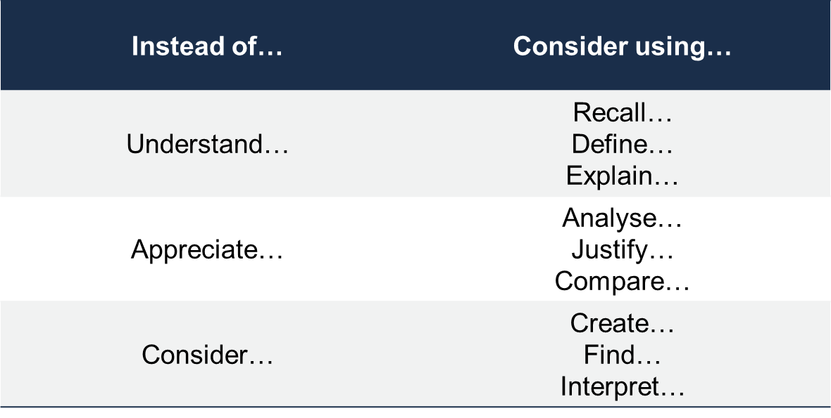
Bloom’s taxonomy
  There’s a useful tool for creating learning outcomes called Bloom’s Taxonomy.
  It contains a list of recommended verbs to include – ones that are objective and verifiable.

Slide 24
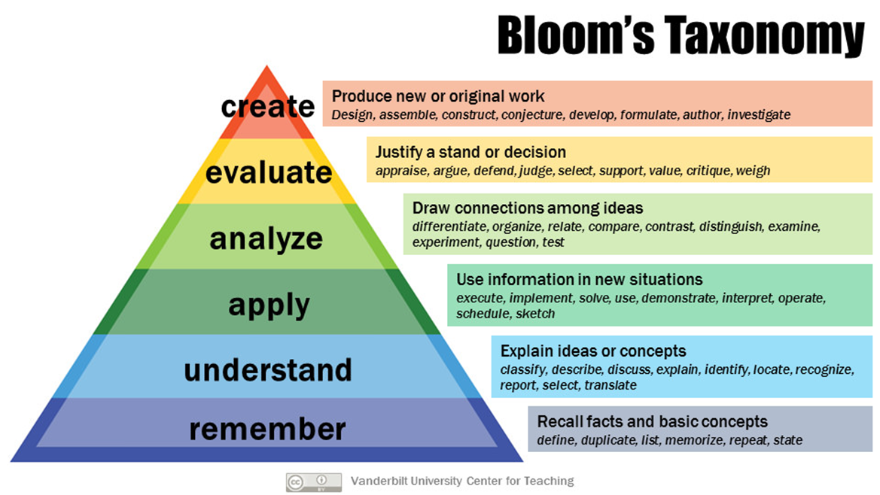
  Bloom’s Taxonomy includes a hierarchy to guide you.
  What level of proficiency do the learners need to demonstrate?
  For basic skills and information, simply being able to recall certain makes may be sufficient.
  For more complex skills, learners may be expected to apply or create specific things.
Armstrong, P. (2010). Bloom’s Taxonomy. Vanderbilt University Center for Teaching. Retrieved 15/06/2022 from https://cft.vanderbilt.edu/guides-sub-pages/blooms-taxonomy/.

Slide 25
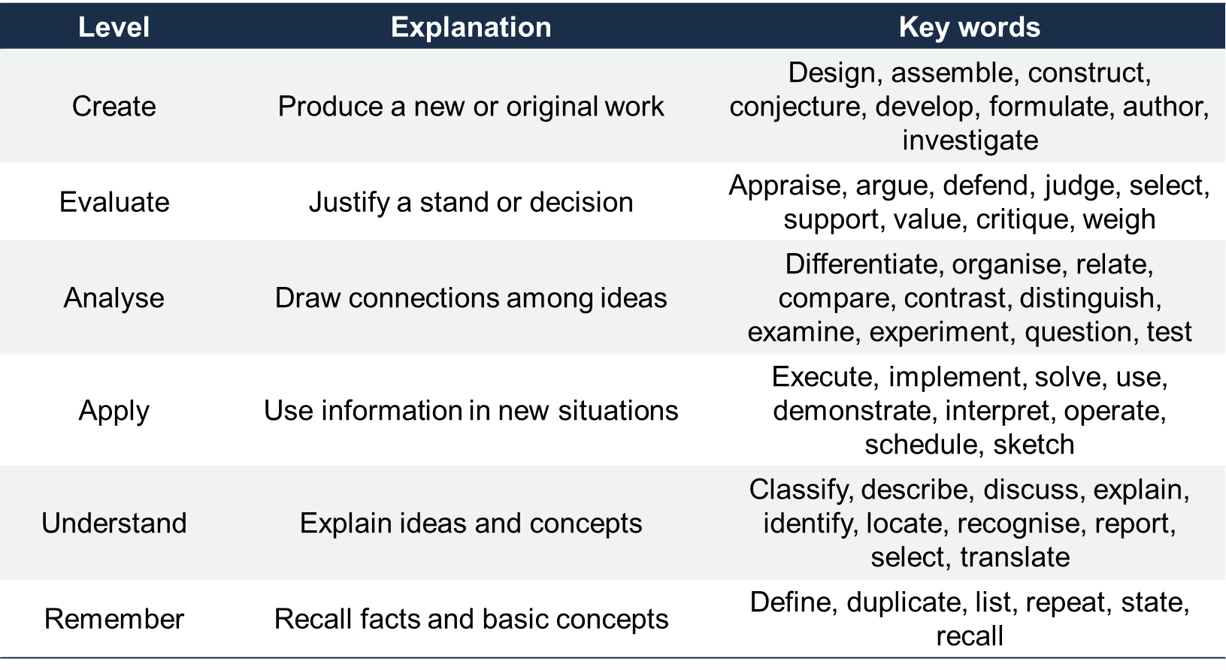
Bloom’s taxonomy
Complexity

Slide 26
What are the bloom’s levels for these learning outcomes?
By the end of this training, you’ll be able to:
Craft learning experiences around the learners’ needs, knowledge level and expectations,
Instil the right attitude in learners before the course even begins, when you clearly define what the learners will get from your course,
Keep the learners’ attention and enthusiasm from start to finish – no matter how “boring” your content is – using the “attention wave” principle,
Cultivate excitement, so that your learners are eager to not only learn but apply what they learn,
Use the “BnW Factor” to lock in principles so deeply, your learners will never forget them,
Build suspense and anticipation when you apply a Hollywood-inspired technique to your lesson design,
Apply the simple loop that engages the learner’s entire mind, reinforcing your content without being repetitive,
Use simple, almost hypnotic language principles that inspires learners to follow your directions and learn more effectively,
Explain what the ultimate learning tool is and how to use it your courses,
Use the “Child at a Theme Park” technique to instil any attitude into your learners,
Apply a principle right out of art school to direct attention anywhere you want it.

Slide 27
Module 2: The Attention Wave
For
Learning Designers
Presenters

Slide 28
The spice of learning
  Think about a really bad presentation you’ve seen or sat through.
  (Or delivered – no judgement here!)
  Think about how the information came across. Forget about that the information was for a moment – what about the delivery made it so dull and hard to focus on?

Slide 29
The spice of learning
  The classically bad presenter is monotonous. Everything comes at the same rate and at the same pitch.
  The classically bad presentation is series of massive block of text.
  But… why?
  And what can we do about that?

Slide 30

Imagine someone telling you something important – maybe they’re sharing exciting news.
They’ll be animated and energised – their tone and pace will vary and their body language will be lively.
Notes:
Photo by Sharon McCutcheon on Unsplash

Slide 31
The boring code
  Monotony is your brain’s code for marking something as boring and unimportant. No one with anything important to say – from talking about their promotion to warning you about the wolves circling your camp – does so in a flat, monotone voice.
  In those cases, you couldn’t keep your voice flat if you tried.
  Presenters often talk in monotone because of nerves or bad habits. Sometimes, it’s because they think the content isn’t interesting – either because they worry it’s not interesting to the audience or because it’s too basic for them.
  Sometimes it’s because the training is so badly designed, it’s boring even to them.
  This is a problem. If something is boring, it’s unpersuasive and your brain doesn’t retain it well.

Slide 32
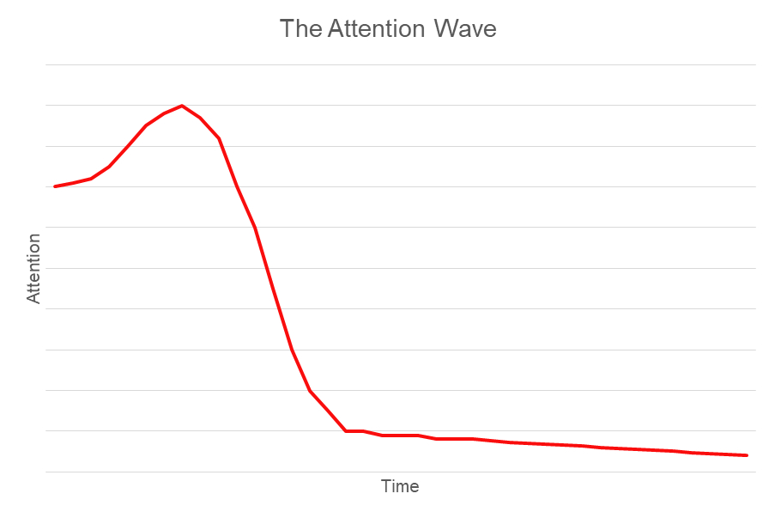
The fascination window
  There’s some good news on this:
  Anything new is interesting, just because it’s new. That means when you start talking – or your learner starts reading your content – you’ll have their attention.
The bad news?
That window closes after a few seconds – if that.
So you don’t have long to capture – and recapture – their attention.

Slide 33
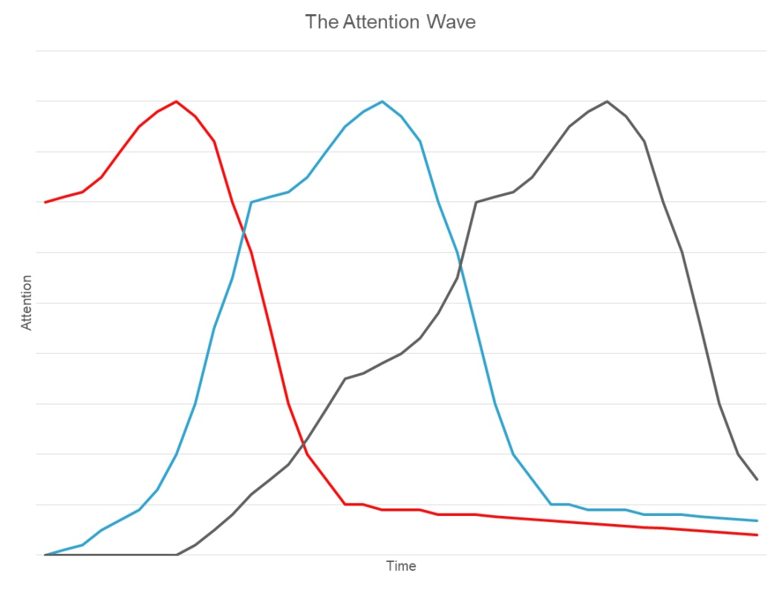
The fascination window
  This means you can keep your learners’ attention – and keep them learning – by giving them something new to focus on every few seconds.

Slide 34
The fascination window
  This means you can keep your learners’ attention – and keep them learning – by giving them something new to focus on every few seconds.
  When presenting, you can achieve this with a melodic voice. When your pitch, tone, volume and speed change every few seconds, it can create this effect.

Slide 35
The fascination window
  This means you can keep your learners’ attention – and keep them learning – by giving them something new to focus on every few seconds.
  When presenting, you can achieve this with a melodic voice. When your pitch, tone, volume and speed change every few seconds, it can create this effect.
  For creating learning resources, this means keeping your content short and adding as much variety as possible.

Slide 36

Take a moment to think
about how you can add
variety to your material.
One thing to consider –
change for change’s sake is less effective than change with a purpose.
This slide is different from the last few. Why? Because I’m asking you to do an exercise, so the change makes sense.
Notes:
Photo by Pratiksha Mohanty on Unsplash

Slide 37
How to add variety – this isn’t a complete list!
When presenting:
Tone
Speed
Volume
Gestures
Position in the room
Emotional quality
Visual aids
Music
Videos and pictures
When creating learning materials:
Page/slide layout
Full paragraphs vs lists
Content – for example, case studies versus theory versus instructions
Exercises
Visual elements – fonts, colours, images
Style – for example, high-energy versus reserved; formal versus humorous

Slide 38
Module 3: Everyone’s Favourite Radio Station
For
Learning Designers
Presenters

Slide 39
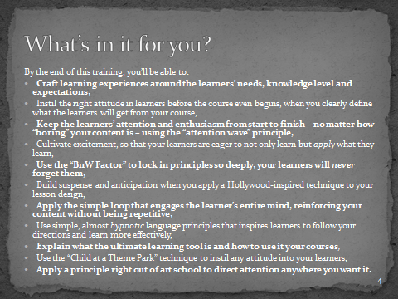
Literally selling your content
  At the start of this slide deck, I told a story about being stopped in the corridor.
  I talked about how I was
  (and sometimes still am)
  thanked for training I’d
  delivered years earlier.
  Then I shared the learning
  outcomes – what you’d be
  able to do by the end of the
  course.
  Why did I do this?

Slide 40
Literally selling your content
  Children are naturally curious – they love to learn for the sake of it.
  Are adults the same way?
  Arguably we are… to an
  extent. But is that the
  whole picture?

Slide 41
Literally selling your content
  Adults are sceptical, time-poor and have
  suffered through bad training in the past.
  Want them to learn?
  Tell them why they
  should learn and why
  they should listen to
  you.

Slide 42
The best radio station - WIIFM
  You might know your content is important – how it well help them do their jobs better.
  That’s not enough. The learners need to know that too.
  It’s no different from marketing. If you want potential customers to buy your gizmo, you have to sell it to them. Same with learning – people learn best when they know why they should.
  You might have heard this one before: Everyone’s favourite radio station is WIIFM, or What’s In It For Me?
  Answer that and your learners will be motivated to learn.

Slide 43
Motivating your learners
  The core to this was way back in Module 1, when we talked about learning outcomes. When you use Bloom’s Taxonomy, you list specific and observable things that learners will be able to do by the end of the course.
  That, in itself, is good marketing.
  Using this course as an example, I talked about you being able to keep learners’ attention and embedding your material in their minds.
  That’s highly motivating for any presenter or learning designer – in other words, for my learners.
  But we can do better…

Slide 44
Motivating your learners
  I also talk about what that means – the So-What Factor. Yeah, you’ll be able to hold a learner’s attention better – so what? Why should you, as a learner of this course, care?
  Because it leads to training that’s so good, people will thank you for it years later.
  Because it means your learners will focus more, learn more, do more and become more.
  Because it makes your training more effective for less work, freeing you to focus on other things.

Slide 45
What your training does and why they should care
  The learning outcomes describe what the learners will be able to do by the end of the course. That’s a great start.
  If you want to inspire people to take your training, and motivate them to learn and apply it, then you need to share what that means for them.
  People are motivated by many things, but a few relevant ones are:
  Ease – will your training make hard tasks easier for them?
  Efficiency – will it save them time, money and/or effort?
  Accomplishment – will it let them achieve more and succeed on challenging tasks?
  Status – will it make them look good in the eyes of their colleagues and customers?
  Necessity – do they need to pass the course for legal or policy reasons?
  Think about what your training really does for them and mention it upfront.

Slide 46
Module 4: The B&W Principle
For
Learning Designers
Presenters

Slide 47
This course’s design
You could accuse me of being inefficient here.
At the start of the course, I listed the learning outcomes. I could have then described exactly how to do each of those things, spending a slide or two on the techniques.
Instead, I’ve spent dozens of slides, going really slowly with it.
Why have I done that? Why have I taken my time, rather than cutting to the chase?

Slide 48
Cliché wisdom
I’m fascinated by cliché wisdom. You know, expressions like:
You can’t love someone until you learn to love yourself,
This too shall pass,
Take more risks,
You can’t put a price on happiness, love or freedom.
  You’ve probably heard each of these a hundred times.
  99 of those times, it doesn’t mean anything. They’re just empty platitudes.
  But have you ever had the experience of those being profound? Of sparking an epiphany, where you find yourself nodding along and realising the deep wisdom it held?

Slide 49
Continuing cliché wisdom
I’ve had that happen to me. A question as simple as “how’s that working out for you?” snapped me out of a months-long funk.
More than once.
How does that work? It’s not like the words are magic – I’d heard and thought those expressions before, to no effect. Then, one day, it was like I could suddenly see what that really meant.

Slide 50
The BnW Factor
What is the BnW Factor?
A reasonable guess it BnW stands for black and white. In this case, it doesn’t.
It stands for Burke and Wills – the explorers who crossed the Australian desert.
Why? Because whoever discovers something interacts with it in a different way. They can explore it, study it and name it.
Driving down someone else’s road means going past all the little details they found along the way.
There’s power in discovery. As one of my mentors likes to say:
An idea that’s presented belongs to the presenter;
An idea that’s discovered belongs to the discoverer.

Slide 51
The BnW Factor
An idea that’s presented belongs to the presenter;
An idea that’s discovered belongs to the discoverer.
This is why reading a Wikipedia article doesn’t make you an expert. It doesn’t matter how thorough it is – it’s someone else’s discoveries, not yours.
It’s also why you can’t replace university courses with text books.
Learning is about discovery, which means learners need to discover.

Slide 52

I could tell you how I
used this principle in
this course… but that
would defeat the point.
How have I led you to discover
some of the key principles
in learning design?
Notes:
Photo by Holly Mandarich on Unsplash

Slide 53
Module 5: Lessons from Hollywood
For
Presenters

Slide 54
Straight out of the movies
How would you like a simple technique that:
  Increases enthusiasm and excitement,
  Uses the What’s In It For Me factor we discussed earlier,
  Boosts retention and focus in your learners?
  Is that something you’d be interested in?

Slide 55
Straight out of the movies
Let’s say you want to promote your upcoming Hollywood blockbuster.
You have many tools available to you. You could have the actors go on interviews, do some viral marketing, take out billboards…
The classic movie promotion tool is the trailer, which tells you everything you need to know about the movie.
But there’s another tool commonly used – one that drops before the trailer. I’m talking about the Teaser.
A Teaser isn’t much – maybe ten seconds or so, maybe showing a closeup of a logo, superhero suit or distinctive character.
If it’s your sort of movie, it’s enough to make you intrigued.

Slide 56
Teasers in learning
You can use Teasers in your presentations.
Suppose you’re about to go on a break. After the break, you’re going to cover something important, useful or interesting.
Right before you dismiss everyone, you could say something like this to the learners:
“How would you like to <achieve an awesome, interesting or useful result>? You would?
Then come back after the break and I’ll show you how.”

Slide 57
Teasers in learning
“How would you like to <achieve an awesome, interesting or useful result>? You would?
Then come back after the break and I’ll show you how.”
This is easy enough to do. It takes a few seconds to say. As for what to put there as your awesome, interesting or useful result, you simply take something from the learning outcomes and the What’s In It For Me descriptions you’ve come up with.
It’s a simple change, but it makes your learners eager and excited to return from the break – which is an excellent state of mind for learning.

Slide 58
Module 6: Language that Leads Learning
For
Presenters

Slide 59
Sales gimmick? Or teaching resource?
If you’ve dealt with salespeople much, you might know of this sales technique:
Building the yes.
The idea is simple: get the customer in the habit of saying yes and they’re more likely to say it when you make the sale:
  “Do you want to make the right choice by your family?”
  “You like to save money without compromising quality, right?”
  “Would you like to be the envy for your neighbours?”
  “Then are you interested in buying this product?”
  Does it work? Yes, but… not if the customer feels the salesperson is just reading a script or trying to take advantage of them. It only works with people who like and trust you – and at that point, do you even need a gimmick like this?

Slide 60
Sales gimmick? Or teaching resource?
I bring this up because that principle can be useful when presenting. It’s a very different technique – no gimmick or high pressure sales tactics here – but the idea behind it is the same.
When you have an exercise for the learners to do, you have a few goals:
  Clarity – you want everyone to know what to do.
  Action – you want them to do it.
  You can achieve both with a simple use of language that’s almost hypnotic in how it works.

Slide 61
Sales gimmick? Or teaching resource?
It’s simple, really:
When you’re giving instructions to the learners, give them to them one at a time. It doesn’t matter what each step is – wait for them to finish each step before moving onto the next.
An example might be:
“Stand up” (wait for everyone to stand)
“Find a partner” (wait for everyone to partner up)
“In pairs, rewrite Hamlet as a surrealist comedy where the characters are social media influencers”
Those steps aren’t equally long or complex, but each is a single instruction.

Slide 62
Why this works
It’s clear how this creates clarity. The learners can’t get confused about the order of events and they can’t accidentally skip a step. If there’s any confusion, you can spot it right there.
The subtler benefit is how it promotes action.
You give an instruction and the learners immediately follow it.
Then you do it again. And again.
This gets them in the habit of following your instructions. After doing what you say two or three times in a row, they’re primed to keep doing it.
Now, this isn’t mind control. It’s a gentle nudge to make them slightly more likely to do the exercises as you instruct them. Little nudges like this can make a huge difference, though.

Slide 63
Being abstract or concrete
Language is a curious tool. It’s surprising how many ways subtle tweaks with it can lead to big changes.
One such tweak is simple but worth knowing.
Sometimes, you want your learners to be precise. There’s a set procedure for dealing with known problems – here’s how they apply it.
Other times, they’ll need to use their judgement.
These two situations call for different language patterns.

Slide 64
Grammar interlude
In English grammar, there’s a class of nouns called nominalisations. These are fascinating words.
You get them by taking an action or a description, and making it into a thing.

Slide 65
Grammar interlude
Examples of nominalisations:
Learnings – as in, “take the learnings from this course with you”. Learning is a verb – a word describing an action. Learnings are things.
Excitement – something can excite you, which is an action. Excitement is a state that comes from that.
Love – you can love something, which is an action. Looking for love, though, treats it as a noun.
We use these all the time in natural language.

Slide 66
Nominalisations in learning
Nominalisations have a way of making things more abstract. They improve creativity at the cost of clarity.
A useful guideline is:
When teaching something precise, repeatable and predictable, avoid nominalisations where possible
When teaching something creative, subjective and with no single right answer, use more nominalisations where possible.

Slide 67
Examples of nominalised text
“Each step of the process is here to maximise results from the applications derived from earlier insights.”
A sentence like that isn’t meaningless – it actually carries a lot of information. How people interpret it, though, will vary.
Used correctly, this can be good. Remember the BnW Factor? This helps cultivate the discovery process in learners. It also helps loosen stuck ideas.
Ask yourself: where do you want learners to develop their own styles and ways of doing things? Nominalisations can help there.

Slide 68
Module 7: The Learning Loop
For
Learning Designers
Presenters

Slide 69
The learning resource framework
Want a simple template you can apply to your exercises, modules and even entire courses?
Here’s something to get you started.
The 4MAT model of learning, created by Bernice McCarthy, comes in a few flavours. If you find this interesting, I recommend looking into it.
Here’s the simple version of it, which contains most of the magic that makes it work. Use this and you’ll never get stuck when designing learning resources, while your learners learn even more than they did before.

Slide 70
4MAT – Phase 1
The 4MAT model loops between four phases:
Phase 1: WHY
You begin by talking about why – why are you teaching this and why should they learn it? This, again, goes back to the learning outcomes and the What’s In It For Me? content.
For this module, I explained how this is a useful framework that makes developing learning material easier and more effective. That’s why you want to learn it and why I want to teach it.

Slide 71
4MAT – Phase 2
The 4MAT model loops between four phases:
Phase 2: WHAT
Once the learners know why they want to learn it, then you move onto what. This introduces the tool, technique, equation or idea that’ll transform how they do things.
For this module, the what is the 4MAT model. When I introduced it, I hadn’t (yet) explained how it works, but I did cover what it was.

Slide 72
4MAT – Phase 3
The 4MAT model loops between four phases:
Phase 3: HOW
They know why they should learn and they know what they’re about to learn. The next step is where you explain how.
Some presenters are overly eager and jump here too soon. They already know why their content is important, but it pays to lead the learners to the same conclusion. It’s quicker and easier to teach someone when they understand the why and the what.
With this module, I’m going into the how now, showing you the ways you can apply this to your courses.

Slide 73
4MAT – Phase 4
The 4MAT model loops between four phases:
Phase 4: NOW WHAT / SO WHAT
Once they’ve experienced how it works, then you review the exercise and what it means for them. They just practiced a skill in a classroom – now what?
Now, they can consider all the ways they’ll apply it back in their role. This is about using what they’ve learned.
Now, they can prepare themselves for the next module or exercise. This is about getting ready to learn more.
You can take a few moments to think of how you can fit your concepts and materials over this framework. It’s simple but powerful.

Slide 74
Module 8: The Ultimate Teaching Tool
For
Learning Designers
Presenters

Slide 75
Talk about a bold claim…
… but it’s one I can confidently make. I know because I’m not the first person to point this out.
Every religion – from world-spanning monotheism to tribal shamanism – uses this as the core of its teachings.
All the great orators, too.
It’s no surprise that I’m talking about stories.

Slide 76
The problem with stories
Yeah, you might already want to put stories into your courses. A lot of presenters and learning designers do.
There’s a problem, though:
Some learners get impatient if you waffle on with “irrelevant” stories. Just get to the point!

Slide 77
Solutions
Here are some things you can do to keep the complaints down:
Keep the stories short. There are times to go into a lot of detail but most learners will appreciate shorter stories to longer ones.
Set expectations. At the start, tell the learners that everything in your course is relevant and essential – that it’s been carefully designed to create the best learning experience.
Make the stories fun. Enough said.

Slide 78
The story layers
There are two types of stories that work well with learning.
The first we could call Level 1 stories. Let’s say you’re teaching a technique to your sales department. Level 1 stories will be about the technique.
Maybe it’ll be about someone not using the technique and not getting the sale. Or it could be about someone using it to get great results.
For crucial things, consider telling both “negative” and “positive” stories, in that order.

Slide 79
The story layers
Level 2 stories are more subtle.
Ask yourself, what needs to be there for the learner to master this? In the sales example, maybe it’s treating the customer with genuine respect.
In that case, a Level 2 story would be about the importance of respect. It might not have anything to do with sales at all – say, a child respecting their parents.

Slide 80
Weaving the story layers
A nice thing you can do with this is combine it with other things we’ve covered. Treat this as a guideline and adapt accordingly:
Begin with a Level 2 story.
Give the learners a Teaser for what they’re about to learn.
Sell them on how important it is with Level 1 stories.
Follow the 4MAT model from there.

Slide 81
Stories can be that simple
That’s a nice, simple framework.
Compared to someone who dives straight into the content, though, you’ll get much better results.

Slide 82
Module 9: Teaching like a Child
For
Presenters

Slide 83
Through the eyes of a child
Many teachers and philosophers will encourage learners to see the world through the eyes of a child.
Be curious and open about everything.
Ask questions. Get your hands dirty. Explore.
It’s good advice. But there’s more to this than it seems. When the instructors are childlike too, interesting things happen.
No, I’m not saying to be curious or immature or anything. This is something else.

Slide 84
Through the eyes of a child
Have you ever done something mind-numblingly boring, simply because a young child wanted to?
Maybe it was playing with dolls or going to a kid’s concert. Boring stuff you’d never choose to do.
Have you ever done anything like that… and found yourself enjoying it?

Slide 85
Through the eyes of a child
It can be fun spending time with children who are having fun. Why? Because their emotions are so intense and pure.
A child laughing at a terrible joke makes the joke funny.

Slide 86
Through the eyes of a child
Emotions are contagious. The more intense they are, the more people around them will share them.
That’s not the only factor at play. It’s not as if you’re doomed to feel whatever someone else is feeling.
But it’s a nudge in that direction. A friend who’s bubbling with excitement can shift you from a neutral, calm feeling into being excited too.

Slide 87
Through the eyes of a child
You’ve probably experienced this often.
But have you considered how to apply that in your teaching?

Slide 88
The value of emotional states
Emotions run deep in the human brain. Nothing we do is purely logical. Even something as self-evident as, “I’m thirsty, so I should get a glass of water” has an emotional component.
That means whatever your sharing with the learners has an emotional component too.

Slide 89
Emotions and learning
What emotions do the experts at this skill feel while doing it?
Pride?
Optimism?
Curiosity?
Determination?
Compassion?
A desire to win?

Slide 90
Emotions and learning
Whatever they need to feel, feel that too while you’re presenting. It doesn’t have to be cheesy or over the top – in fact, subtle and natural is better.
Bring to mind what it’s like for you to do this skill.
Let yourself feel whatever you feel and let that shine out of you.
This will take some practice for some of you, but it’ll lead your learners to where they need to go – emotionally, not just intellectually.

Slide 91
Module 10: Negative Space and Positive Thoughts
For
Learning Designers
Presenters
Notes:
(Contrast)

Slide 92
A tip right out of art school
Want to draw the learner’s attention to some important point?
Sometimes, all it takes it a little bit of…

Slide 93
C O N T R A S T

Slide 94
Drawing the eye and the mind
The human brain naturally looks for patterns. It can’t not – that’s hardwired deep into us.
That means that things that break patterns stand out.
This is similar to the Attention Wave from earlier, but with an important difference. The Attention Wave involves mixing things up to keep people focused. That doesn’t call for more than a slight variation every now and then.

Slide 95
Drawing the eye and the mind
With the Attention Wave, most of the elements remain consistent. It might be nothing more than a slight shift in pitch, volume or speaking rate.
Contrast, though, calls for a bigger shift.
Before you can do that,
you need to establish a pattern.

Slide 96
Drawing the eye and the mind
It’s good to use contrast sparingly. If every point is important, then nothing is. If everything contrasts, then there’s nothing for it to contrast against.
What are the essential elements of your material? I’m sure it’s all important, but what’s more essential, fundamental or crucial for the learners to take away?
Some things are the cornerstone of what you’re teaching. Draw attention to those with contrast – it’ll help them stick in the learners’ minds.

Slide 97
Module 11: Review
For
Learning Designers
Presenters

Slide 98
Reviewing the Learning Outcomes
At the beginning of this course, I made some big claims.
Let’s see how we did.

Slide 99
Reviewing the Learning Outcomes
Craft learning experiences around the learners’ needs, knowledge level and expectations,
Instil the right attitude in learners before the course even begins, when you clearly define what the learners will get from your course,
Cultivate excitement, so that your learners are eager to not only learn but apply what they learn,
Build suspense and anticipation when you apply a Hollywood-inspired technique to your lesson design,
We explored these in Module 1. When you create precise and measurable learning outcomes using Bloom’s taxonomy, you’ll know exactly what your learners will get from your course and why they’d want to take it.
When you enhance them with the What’s In It For Me? techniques in Module 3, they become even stronger.
Those modules both help build excitement, suspense and anticipation – so do the Teasers from Module 5.

Slide 100
Reviewing the Learning Outcomes
Keep the learners’ attention and enthusiasm from start to finish – no matter how “boring”
your content is – using the “attention wave” principle,
I don’t believe in boring content, but there are boring deliveries. A handy way around that is in Module 2 – using the attention wave to inject some novelty just as the learners’ focus begins to wane.
Using contrast as described in Module 10 also helps.

Slide 101
Reviewing the Learning Outcomes
Use the “BnW Factor” to lock in principles so deeply, your learners will never forget them,
We discussed the Burke and Wills Factor in Module 4. It’s built around the idea that an idea that’s presented belongs to the presenter, while an idea that’s discovered belongs to the discoverer.
Want your learners to remember something deep in their bones? Don’t tell them about it – help them to discover it for themselves.

Slide 102
Reviewing the Learning Outcomes
Apply the simple loop that engages the learner’s entire mind,
reinforcing your content without being repetitive,
This is the 4MAT model from Module 7. This learning loop constantly primes the learners for what’s about to come and how they can use it in their roles. When running an exercise, building a module or designing the entire course, consider explaining the Why, What, How and Now What of the content.

Slide 103
Reviewing the Learning Outcomes
Use a simple, almost hypnotic language principle
that inspires learners to follow your directions.
Module 6 covered a simple but power notion:
One thing at a time.
When giving instructions, you’ll get better results by giving them one at a time. This language pattern leads learning by creating clarity and action.

Slide 104
Reviewing the Learning Outcomes
Explain what the ultimate learning tool is and how to use it your courses,
Storytelling in a training context – the ultimate teaching tool – was covered in Module 8. We talked about different sorts of stories and how to use them.

Slide 105
Reviewing the Learning Outcomes
Use the “Child at a Theme Park” technique to instil any attitude into your learners,
Emotional states and attitudes are contagious. Module 9 went into details about how and why to use that.

Slide 106
Reviewing the Learning Outcomes
Apply a principle right out of art school to direct attention anywhere you want it.
Again, we explored this in Module 10 when talking about the power of contrast. Used well, contrast can highlight your most important ideas, techniques and principles.

Slide 107
What now?
When it comes to learning new skills, it’s not enough to read something like this. To learn it for yourself, you have to apply it.
Take some new or existing learning resource that you’re responsible for. Now wonder how you can apply these lessons to both the design and delivery of it.
Do this and you’ll find significantly better results.

Slide 108
What now?
Want to talk more? You can find me at:
https://www.linkedin.com/in/battenwilliam/
https://williamtbatten.com/
Thanks for reading. I trust you got some insight from it.

